Slide 1
Introduction to Electric and Electronics
Chapter 2 – Homework

Slide 2
Homework
Homework #1
Solve Problems 2.35, 2.40, 2.48, 2.51, 2.55 Submit by September 27th
Read Text Chapter 3.
Prepare Presentation

Slide 3
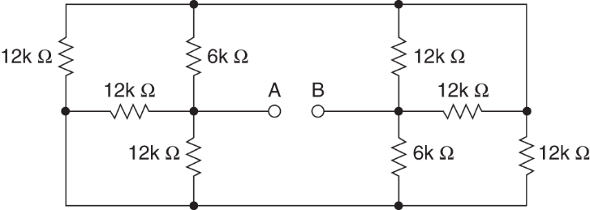
Homework #1
Problem #1
Determine the resistance at the terminals A-B in the circuits in Figure P2.35 Figure P2.35

Slide 4
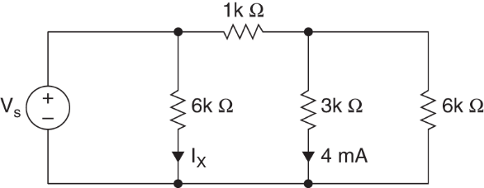
Homework #1
Problem #2
2. Find V_{s} and I_{x} in the network in Figure P2.40 Figure P2.40

Slide 5
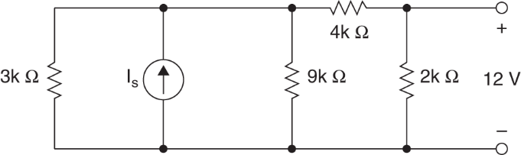
Homework #1
Problem #3
3. Find I_{s} in the network in Figure P2.48 Figure P2.48

Slide 6
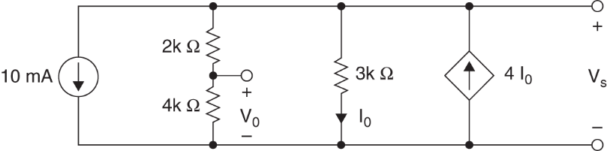
Homework #1
Problem #4
4. Find the voltage V_{o} in the network in Figure P2.51 Figure P2.51

Slide 7
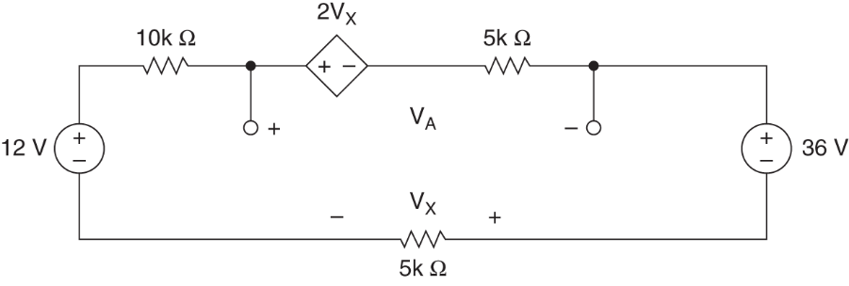
Homework #1
Problem #5
5. Find V_{A} in the network in Figure P2.55 Figure P2.55

